Slide 1
Graymills: A Local Firm
Plays on the Global Stage
IMTS and Midwest Clean Tech 2012
8 February 2012

Slide 2
Agenda
Who Are We?
A Global Market
Clean & Green
Questions?

Slide 3
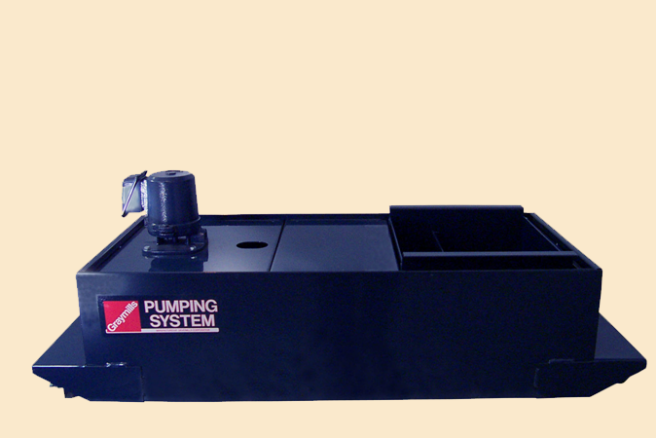
Graymills starts – industrial pumps
  The company began by building pump and tank systems for machine tools in 1939. Today, we supply many key machine tool builders worldwide.

Slide 4
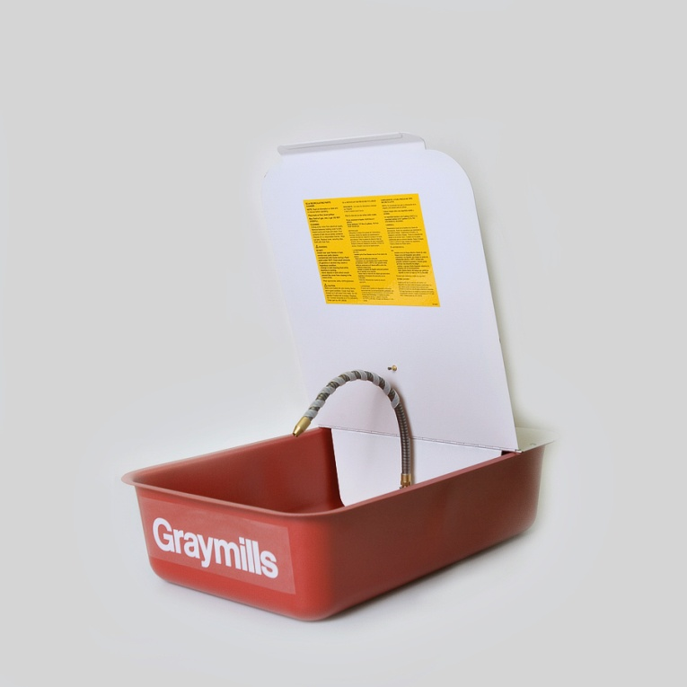
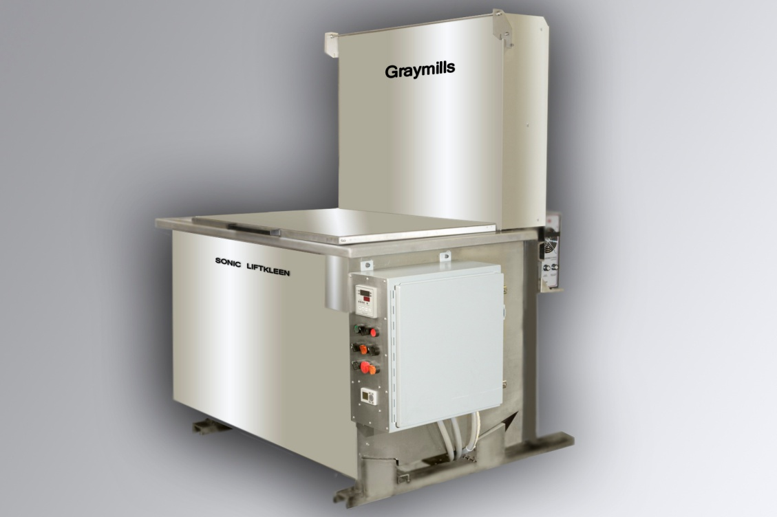
New post-war market – washers for industry and automotive
Finding the market for pumps soft with all the war surplus, the company added legs to a steel tank, making an industrial parts cleaner.
Today we offer products from benchtop units to ultrasonic cleaners that can hold several engine blocks.

Slide 5
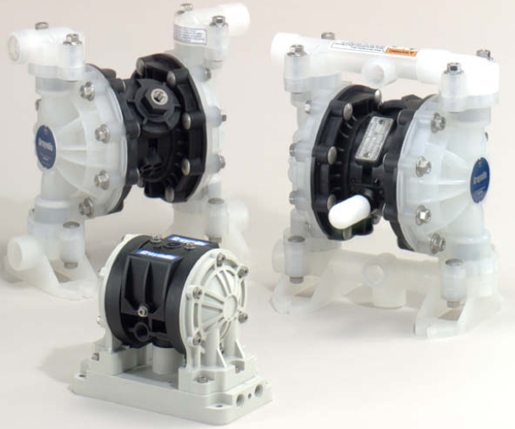
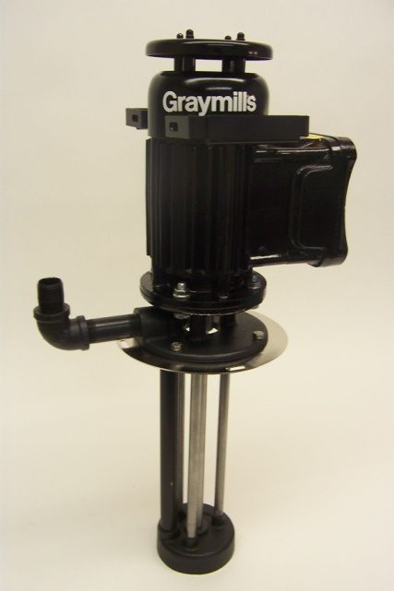
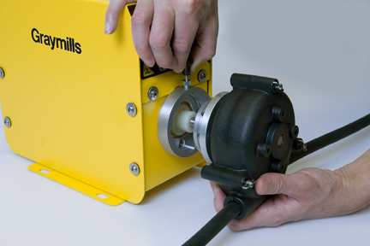
Serendipity – inking systems
As aniline printing phased out because of health concerns, liquid inks became more popular. Coincidentally, the key manager at Sun Chemicals was a golfing buddy of the owner of Graymills.
Today Graymills dominates flexo and gravure markets in the US, Europe (and now India!) and offers a full range of products, including pumps, tanks, filters, and viscosity controls.
Peristaltic Pump
Diaphragm Pump
Centrifugal Pump

Slide 6
Graymills Today
120,000 square feet in Chicago’s Northcenter neighborhood.
  Design (Solidworks, COSMOS, 3D printing, test labs, etc.)
  Machine shop (7 CNC machines)
  Sheet metal fab (laser, CNC bender, welding, powder coat)
  Assembly, testing, and shipping
  The ONLY manufacturing firm in the whole world with the El running through its loading bays
75 employees:
  70 in Chicago
  5 telecommuters in Lake Forest, Scottsdale, Dallas, Minneapolis, New Jersey
  Board members of AIM and NORBIC

Slide 7
Agenda
Who Are We?
A Global Market
Clean & Green
Questions?

Slide 8
Why does Graymills Export?
One one level it’s purely a matter of market size. The US is only a piece of the global market, and it is very saturated.
Our customers are global, especially in the printing industry. If we want to sell to the big printing press OEMs – even the American ones – we need to be able to support them where they sell. Standards, service, spares.
Being global creates pull from the OEMs’ own customers. If they are familiar with our products, they might demand them.
In all honesty, it’s fun (if sometimes a bit scary). Don’t underestimate how important this is.

Slide 9
Where does Graymills Export?
Industrial pumps:
  Only Canada currently
  Looking at an acquisition in Europe as a launching pad
Parts washers:
  Sell limited amounts direct globally
  Strong in Canada
  One large distributor in Europe
  Talking to manufacturing partner in Europe to expand
Inking systems:
  Very strong in Canada and Europe
  Increasingly strong in India and Central America
  Asia, Middle East, and East Africa next targets

Slide 10
How does Graymills Export?
39 agent-distributors
  Legally distributors (take possession of goods, etc.)
  Exclusive territories
  Sell direct to end users (set own price) and work with factory on OEMs and large accounts (we set price)
  Lesson learned – put agreements in writing, even if you use US contract language
US-based international sales manager
  Off-site in Dallas
  Manages reps and helps to coordinate leads and needs with the factory
  Acts as ombudsman for the foreign territories

Slide 11
Graymills and IMTS
We exhibit our industrial pumps an parts washers only.
We have been in more shows than I can recall – usually as exhibitors AND buyers.
While many shows have been decimated by the availability of online information, we have found that IMTS continues to draw the manufacturing community who want to see the machinery in person.
We find that the average lead from IMTS is very high-quality and motivated. They typically have problems they need solved, rather than being browsers.
The show usually draws a large international contingent, allowing us to reach foreign customers we otherwise would miss.

Slide 12
Agenda
Who Are We?
A Global Market
Clean & Green
Questions?

Slide 13
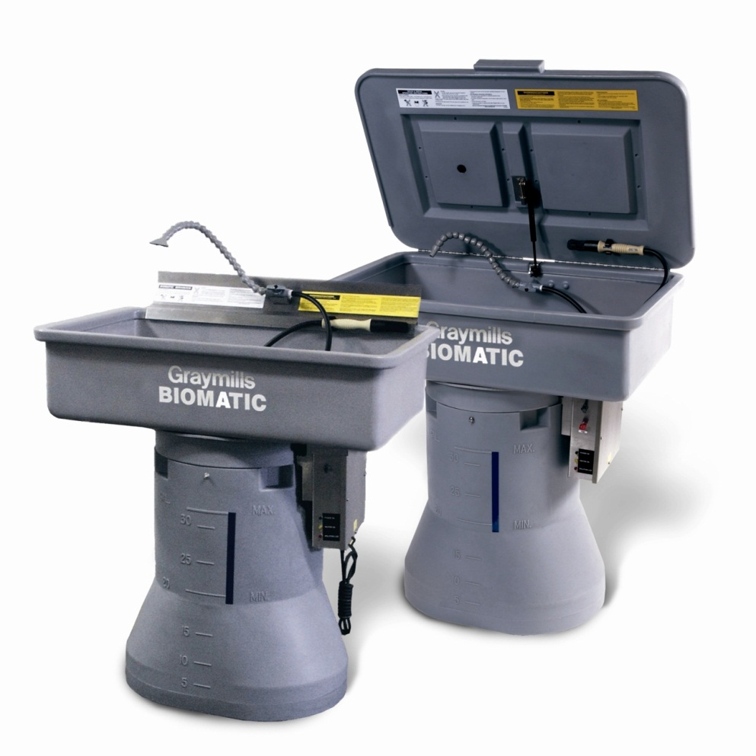
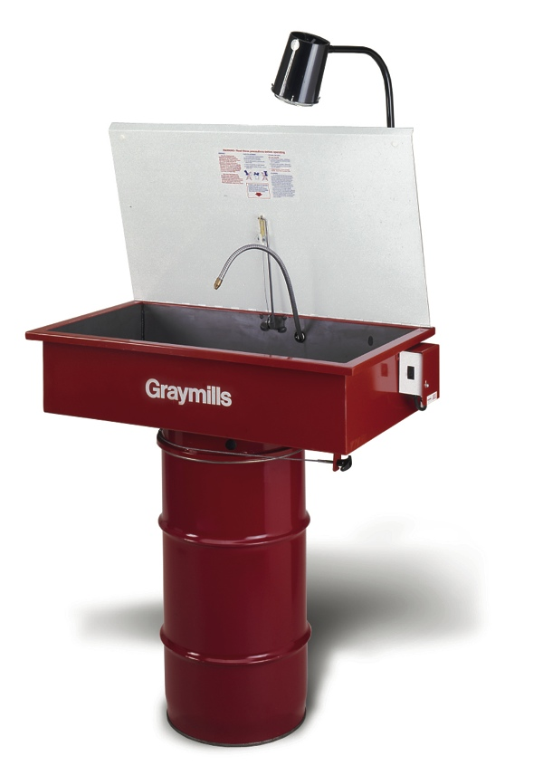
Graymills has been involved with several green initiatives.
Industrial cleaning – petroleum solvents to aqueous to bioremediation:

Slide 14
Graymills has been involved with several green initiatives.
Printing: High-VOC solvent-based to water-based to UV. Though driven by emission requirements, the technology is the result of the work of many companies in the industry.
Graymills will be launching a new technology in 2012 that will allow water-based and UV printers to reach a level of quality that currently requires solvent.

Slide 15
Agenda
Who Are We?
A Global Market
Clean & Green
Questions?

Slide 16
Any questions?

